Slide 1

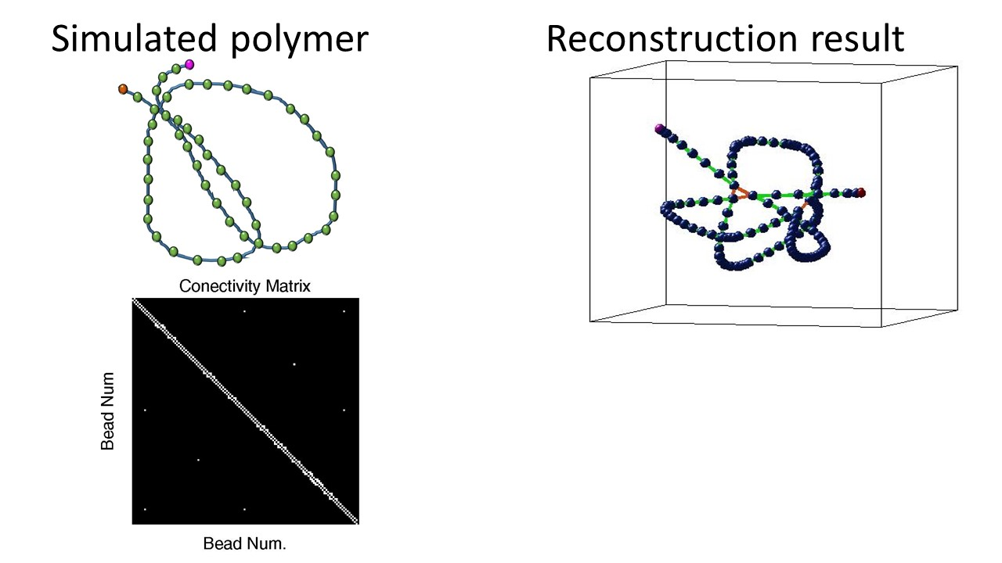
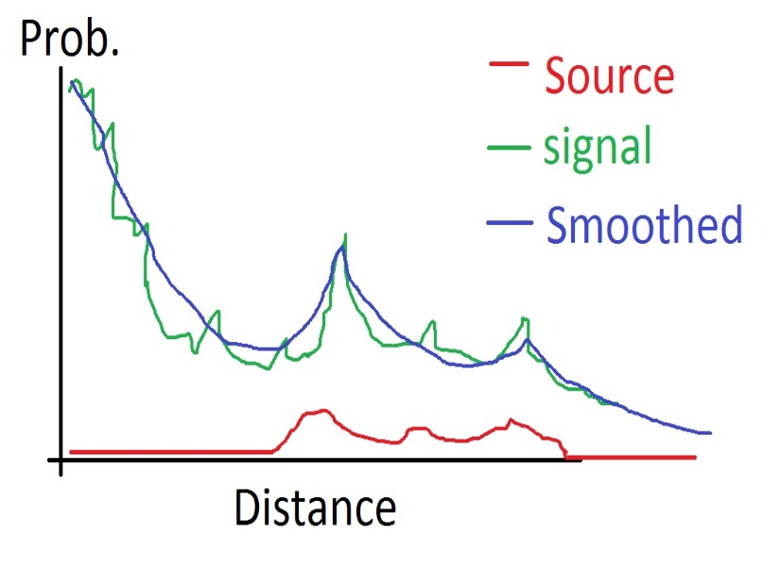
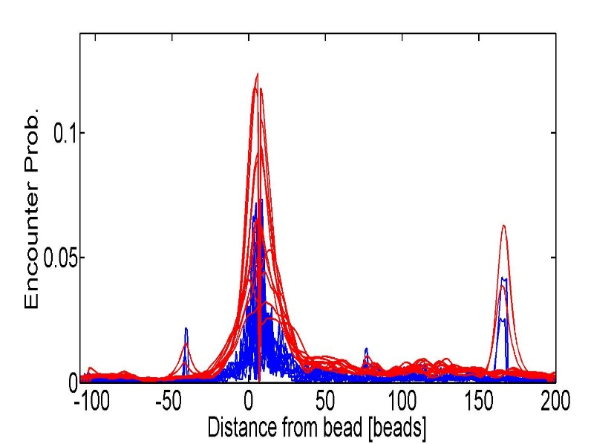
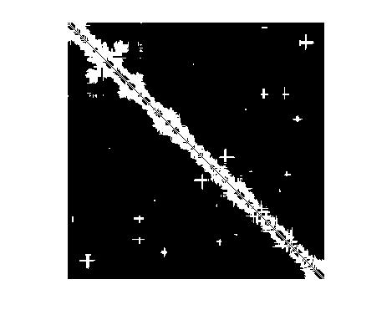
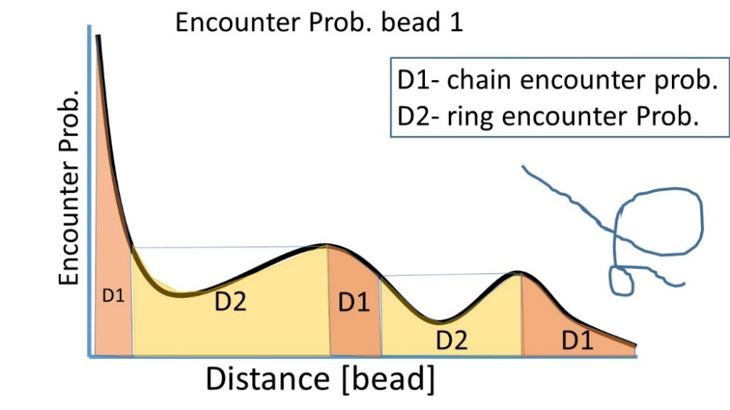
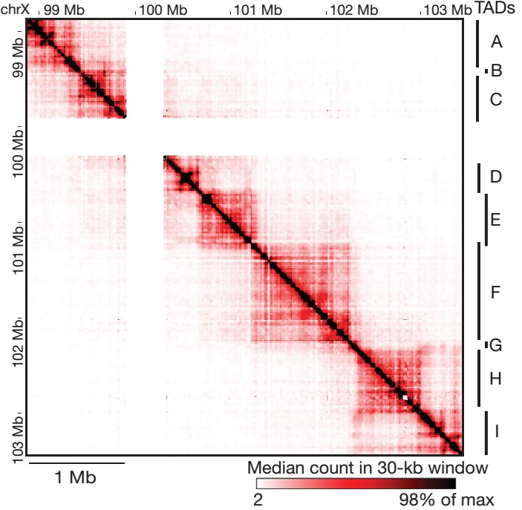
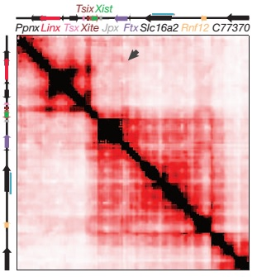
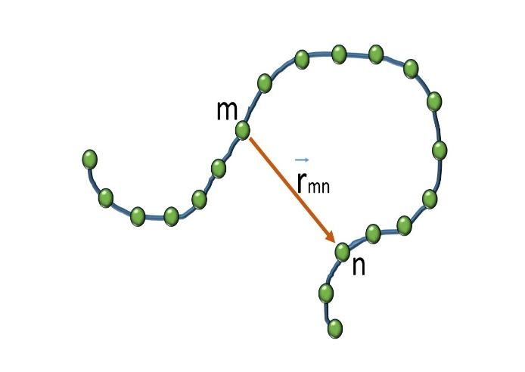
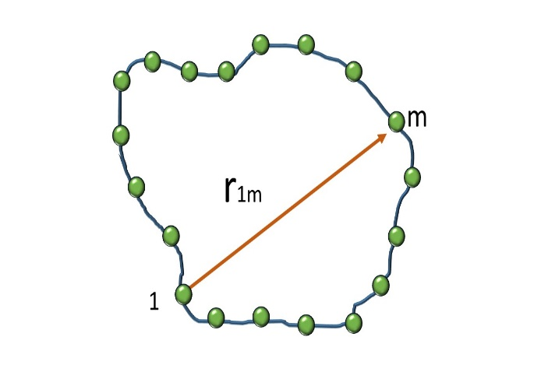
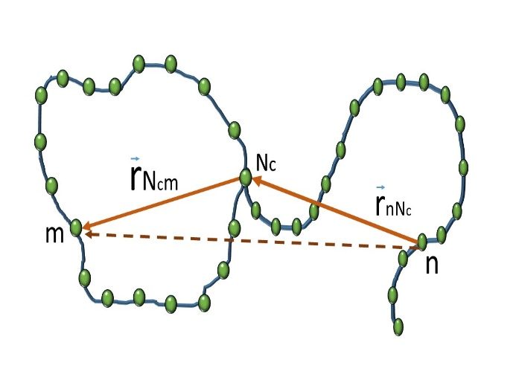
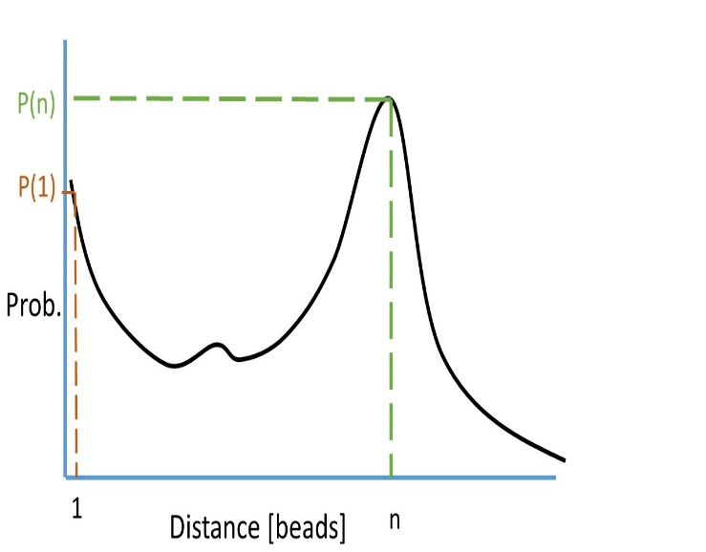
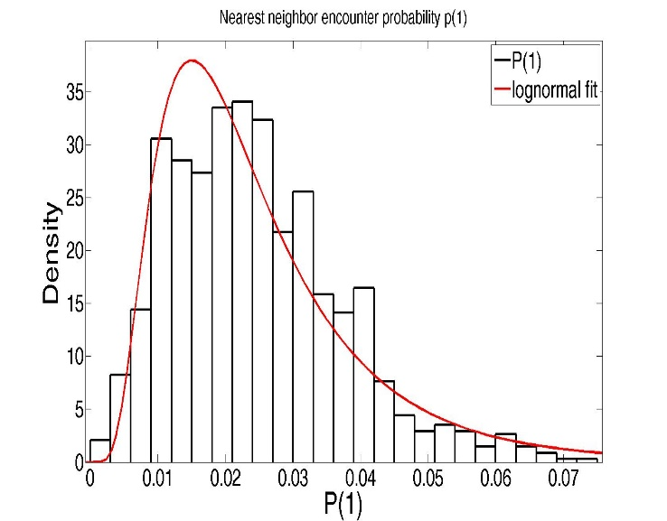
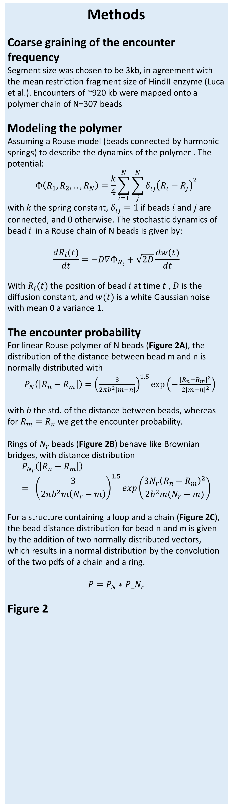
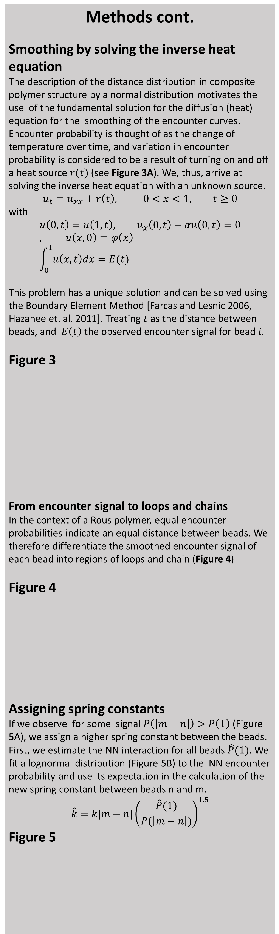
Reconstruction of the chromatin organization using HiC encounter frequency maps
Ofir Shukron, David Holcman,
IBENS, Ecole Normale Superieure , 46 rue d’Ulm, 75005, Paris, France
Goal
Reconstruct the local polymer architecture using HiC encounter frequency maps.
Study the dynamic properties of the resulting structure, the encounter time distribution and Mean First encounter time (MFET) between different parts of a polymer.
By Providing a tool to transform static HiC encounter map to an average polymer structure, which captures salient features in the chromosome microstructure of the examined cells, allowing further analysis and simulation of the dynamics of a cross-linked polymer in various scenarios.
Background
HiC experiment simultaneously captures millions of looping events of the chromosome. HiC steps are presented in Figure 1A.
Analysis of the HiC encounter frequencies in mouse embryonic stem cells reveals the presence of stable Topologically Associating Domains (TAD) [Nora PE 2012] , in the 4.5Mb region of the X inactivation center Figure 1B. However, the actual architecture in a specific stage of cell life is unknown
The data
We use a subset of ~1Mb region of the X-chromosome around the X- inactivation center, provided by G.Luca et. Al.
Methods
Coarse graining of the encounter frequency Segment size was chosen to be 3kb, in agreement with the mean restriction fragment size of HindII enzyme (Luca et al.). Encounters of ~920 kb were mapped onto a polymer chain of N=307 beads
Modeling the polymer
Assuming a Rouse model (beads connected by harmonic springs) to describe the dynamics of the polymer . The potential: $$Φ\left(R_{1},R_{2},..,R_{N}\right)=\frac{k}{4}\sum_{i=1}^{N}{\sum_{j}^{N}{{δ_{ij}\left(R_{i}−R_{j}\right)}^{2}}}$$ with $k$ the spring constant, $δ_{ij}=1$ if beads $i$ and $j$ are connected, and 0 otherwise. The stochastic dynamics of bead $i$ in a Rouse chain of N beads is given by:
$$\frac{dR_{i}(t)}{dt}=−D∇Φ_{R_{i}}+\sqrt{2D}\frac{dw(t)}{dt}$$
With $R_{i}(t)$ the position of bead $i$ at time $t$ , $D$ is the diffusion constant, and $w(t)$ is a white Gaussian noise with mean 0 a variance 1.
The encounter probability
For linear Rouse polymer of N beads (Figure 2A), the distribution of the distance between bead m and n is normally distributed with $P_{N}\left(\left|R_{n}−R_{m}\right|\right)={\left(\frac{3}{2πb^{2}|m−n|}\right)}^{1.5}exp⁡\left(−\frac{{\left|R_{n}−R_{m}\right|}^{2}}{2{\left|m−n\right|}^{2}}\right)$ with $b$the std. of the distance between beads, whereas for $R_{m}=R_{n}$ we get the encounter probability.
Rings of $N_{r}$ beads (Figure 2B) behave like Brownian bridges, with distance distribution
$$P_{N_{r}}\left(\left|R_{n}−R_{m}\right|\right)= {\left(\frac{3}{2πb^{2}m\left(N_{r}−m\right)}\right)}^{1.5}exp\left(\frac{3N_{r}{\left(R_{n}−R_{m}\right)}^{2}}{2b^{2}m(N_{r}−m)}\right)$$
For a structure containing a loop and a chain (Figure 2C), the bead distance distribution for bead n and m is given by the addition of two normally distributed vectors, which results in a normal distribution by the convolution of the two pdfs of a chain and a ring.
$$P=P_{N}∗P_N_{r}$$
Figure 2
Methods cont.
Smoothing by solving the inverse heat equation
The description of the distance distribution in composite polymer structure by a normal distribution motivates the use of the fundamental solution for the diffusion (heat) equation for the smoothing of the encounter curves. Encounter probability is thought of as the change of temperature over time, and variation in encounter probability is considered to be a result of turning on and off a heat source $r(t)$ (see Figure 3A). We, thus, arrive at solving the inverse heat equation with an unknown source.
$$u_{t}=u_{xx}+r\left(t\right), 0<x<1, t≥0$$
with $$u\left(0,t\right)=u\left(1,t\right), u_{x}\left(0,t\right)+αu\left(0,t\right)=0, u\left(x,0\right)=φ\left(x\right) \\ \int_{0}^{1}{u\left(x,t\right)dx=E(t)}$$
This problem has a unique solution and can be solved using the Boundary Element Method [Farcas and Lesnic 2006, Hazanee et. al. 2011]. Treating $t$ as the distance between beads, and $E\left(t\right)$the observed encounter signal for bead $i.$
Figure 3
From encounter signal to loops and chains
In the context of a Rous polymer, equal encounter probabilities indicate an equal distance between beads. We therefore differentiate the smoothed encounter signal of each bead into regions of loops and chain (Figure 4)
Figure 4
Assigning spring constants
If we observe for some signal $P\left(\left|m−n\right|\right)>P\left(1\right)$ (Figure 5A), we assign a higher spring constant between the beads. First, we estimate the NN interaction for all beads $\hat{P}(1)$. We fit a lognormal distribution (Figure 5B) to the NN encounter probability and use its expectation in the calculation of the new spring constant between beads n and m. $$\hat{k}=k|m−n|{\left(\frac{\hat{P}(1)}{P(\left|m−n\right|)}\right)}^{1.5}$$
Figure 5
Results
Validation
Validation with synthetic data To test our method we start with a known structure (Figure 7A) and simulate its dynamics to get the encounter signals. Applying our method, we get an excellent agreement with the initial structure Figure 7B, as can be seen from the connectivity matrix Figure 7C.
Figure 7
Reconstruction of the HiC data
The connectivity matrix of the of the resulting structure is shown in Figure 8.
Summary
We have developed a method to reconstruct the mean architecture of a polymer using HiC data, capturing its salient features;
Examination of the method shows excellent agreement with synthetic data, exemplifies the robustness of our method;
We have presented a novel use of the solution of the inverse heat equation to smooth HiC data based on the underlying assumption of a Rouse polymer.
We have offered a simple and straightforward way to adjust the spring constants for highly interacting beads
Resulting structure can be simulated and analyzed for both equilibrium and non equilibrium dynamics
Perspectives
Further investigation into the resulting structure from HiC experiments will be carried out;
A much more accurate result can be obtained using synchronized cell cycle samples;
A measure for the similarity between the simulated encounter probability and the observed one should be incorporated
A
B
C
Connected beads (highlighted) not connected
A
B
References
[Nora PE 2012] Nora, Elphège P., et al. "Spatial partitioning of the regulatory landscape of the X-inactivation centre." Nature 485.7398 (2012): 381-385.
[Luca G 2014] Giorgetti, Luca, et al. "Predictive polymer modeling reveals coupled fluctuations in chromosome conformation and transcription." Cell 157.4 (2014): 950-963.
[Farcas , Lesnic 2006] Farcas, Adrian, and Daniel Lesnic. "The boundary-element method for the determination of a heat source dependent on one variable." Journal of Engineering Mathematics 54.4 (2006): 375-388.
[Hazanee 11] Hazanee, A., et al. "An inverse time-dependent source problem for the heat equation." Applied Numerical Mathematics 69 (2013): 13-33.
[Amitai A, Holcman D 2013] Computing DNA
Looping, Stat. Phys. 2013
[Amitai A, Holcman D 2013] beta-model application
to DNA modeling in the nucleus, PRE 88, 052604
2013
[Amitai A, Holcman D], Diffusing Polymers in
Confined Microdomains and Estimation of
Chromosomal Territory Sizes from Chromosome
Capture Data Phys. Rev. Lett. 110, 248105 (2013)
Figure 8
Connected beads (highlighted) not connected
Figure 1
A
1. Cross-linking the polymer using formaldehyde
2. HindIII digestion
Polymer cross-links
3. Ligation
B
4. Reverse cross-linking, and PCR
A. Chain
B. Ring
C. Composite
Nora et. al 2012
A
B

